Slide 1
Wholesaling as a Value-Add for WISPs
Wireless Nation
Tom Linn
23 Jan 2020

Slide 2

About WN
Founded in 2005
Satellite BB since 2006
Vodafone 3G/4G RBI
Spark 4G Fixed Wireless
UFB & DSL
FTTB

Slide 3



Wholesale Tail Types
L1/2 ports/tails
Fully managed plans
Shared pools

Slide 4
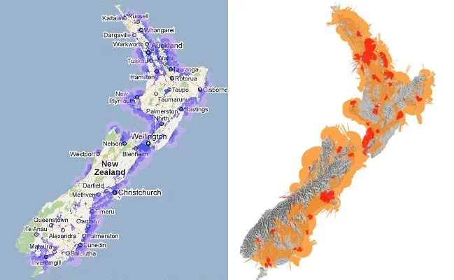
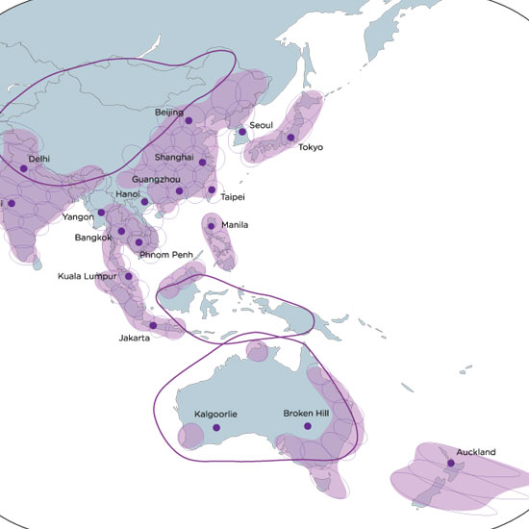
Benefits
Minimal resources required to manage the network
Wider service footprint
  National
  International
Can laser focus on customer service and growth opportunities
Access to suppliers’ marketing resources
Less headache to keep track of technology changes overall

Slide 5



Concerns
Less flexible
Competing with wholesaler sometime
Smaller margins
Required good OSS/BSS
Resource required to check suppliers’ billing errors

Slide 6

Value-Add Opportunities
NZ Mobile
IoT
Managed WiFi
More ...

Slide 7
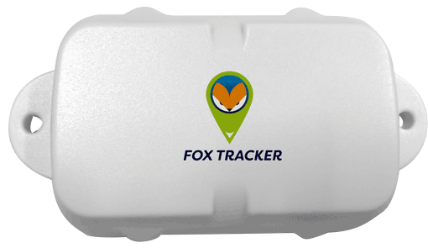
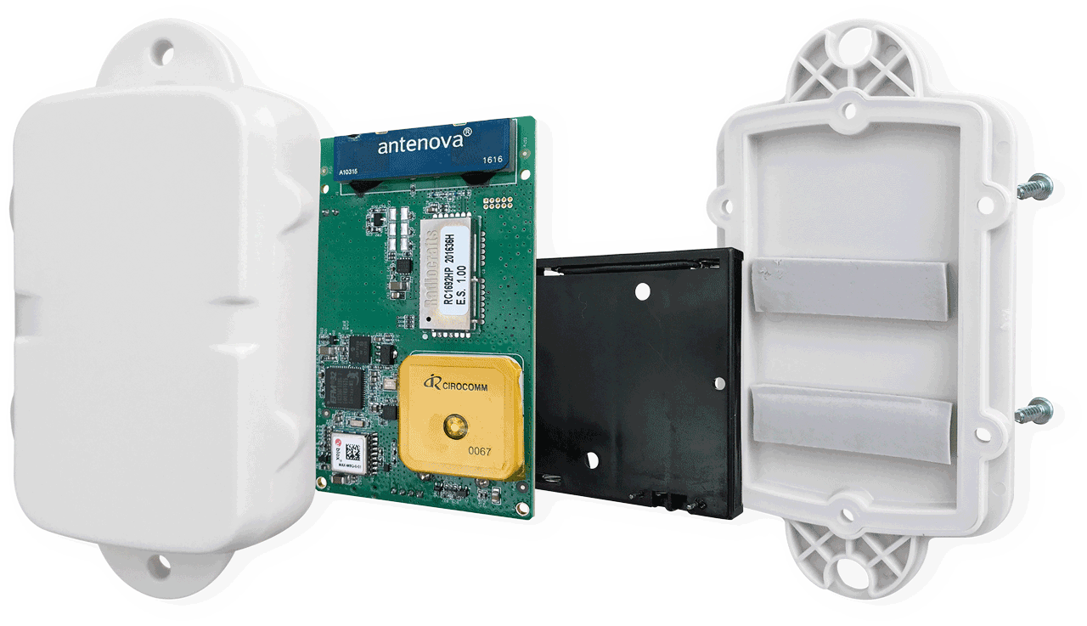
Value-Add Example - IoT Tracker

Slide 8
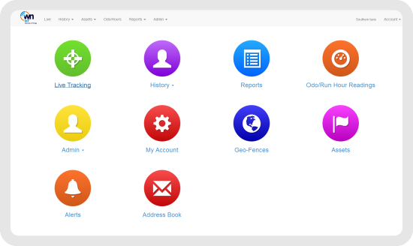
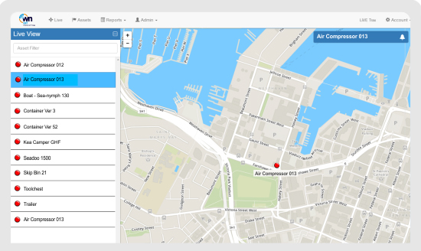
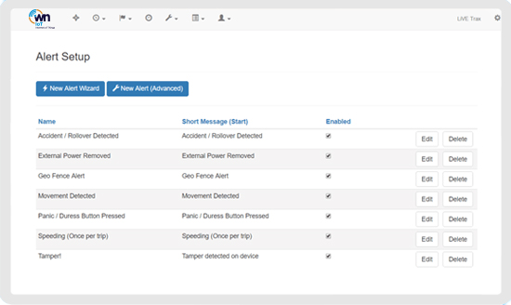
Value-Add Example - IoT Tracker

Slide 9
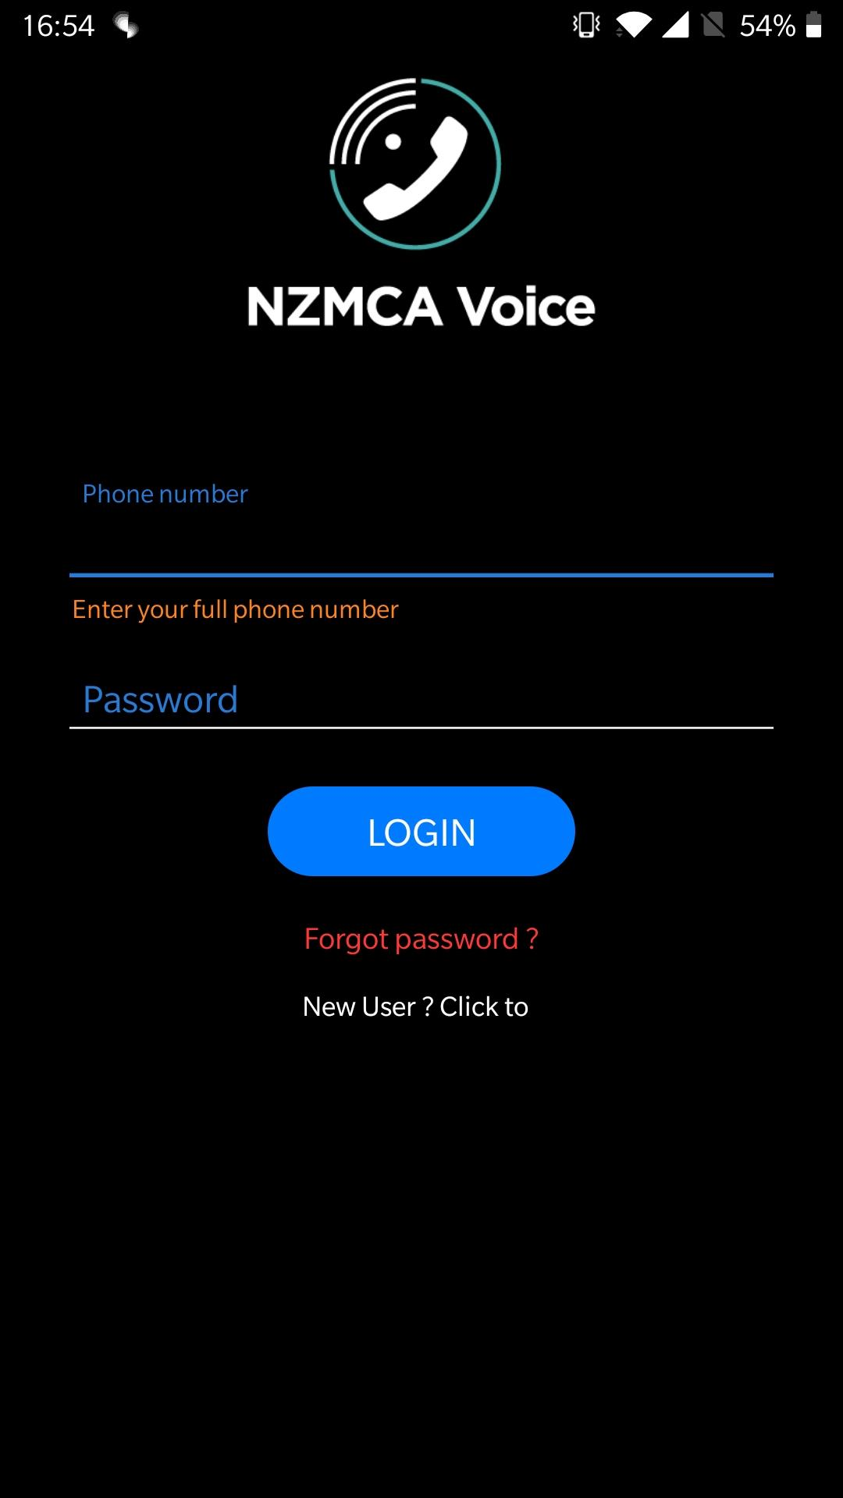
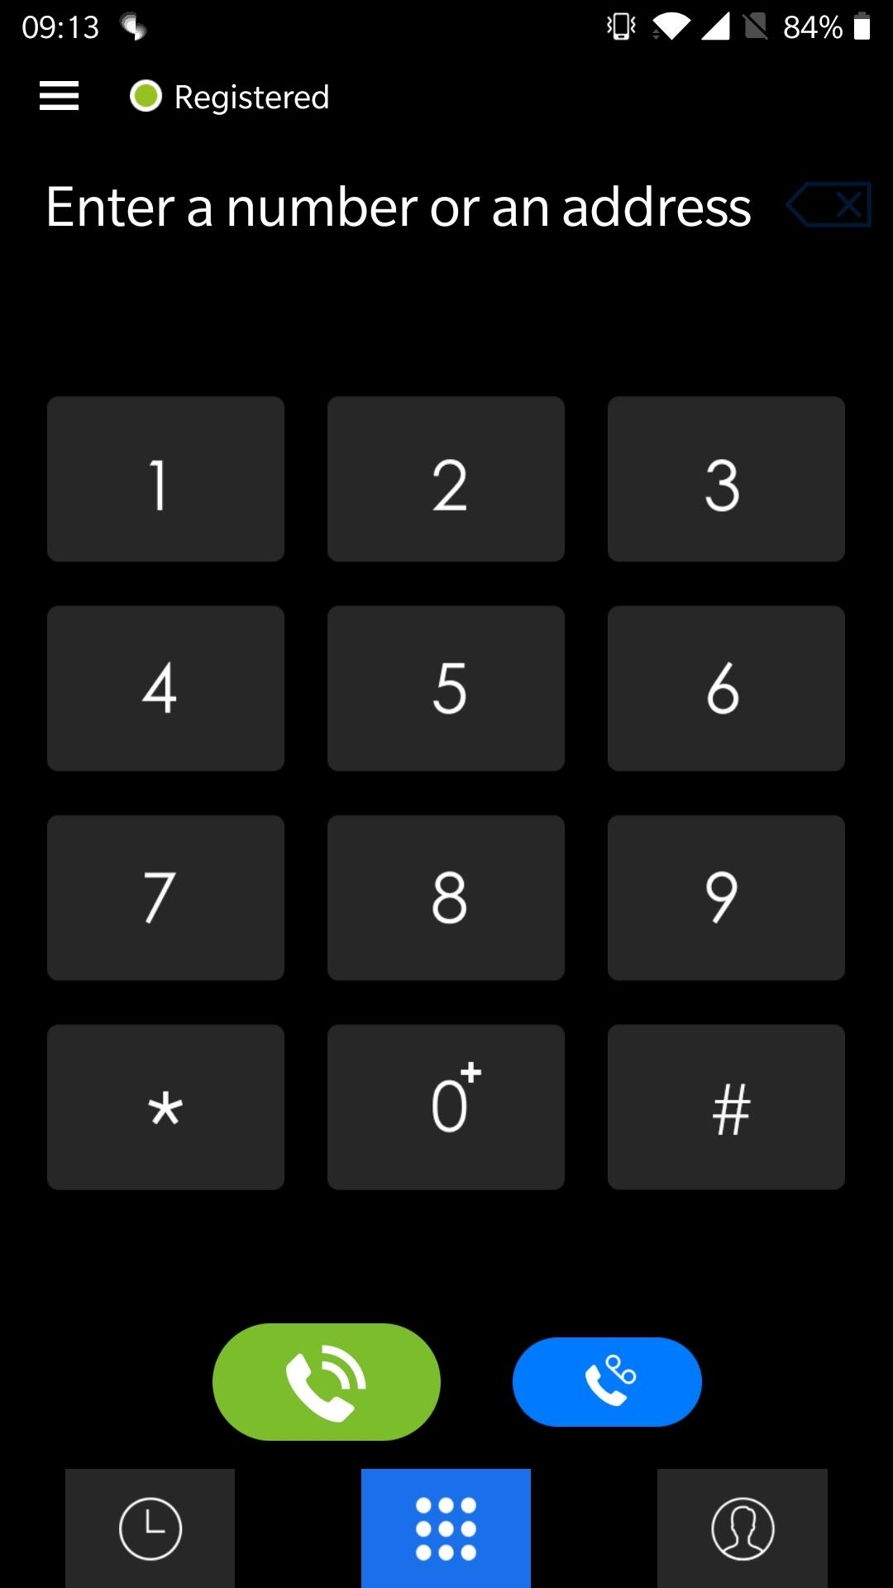
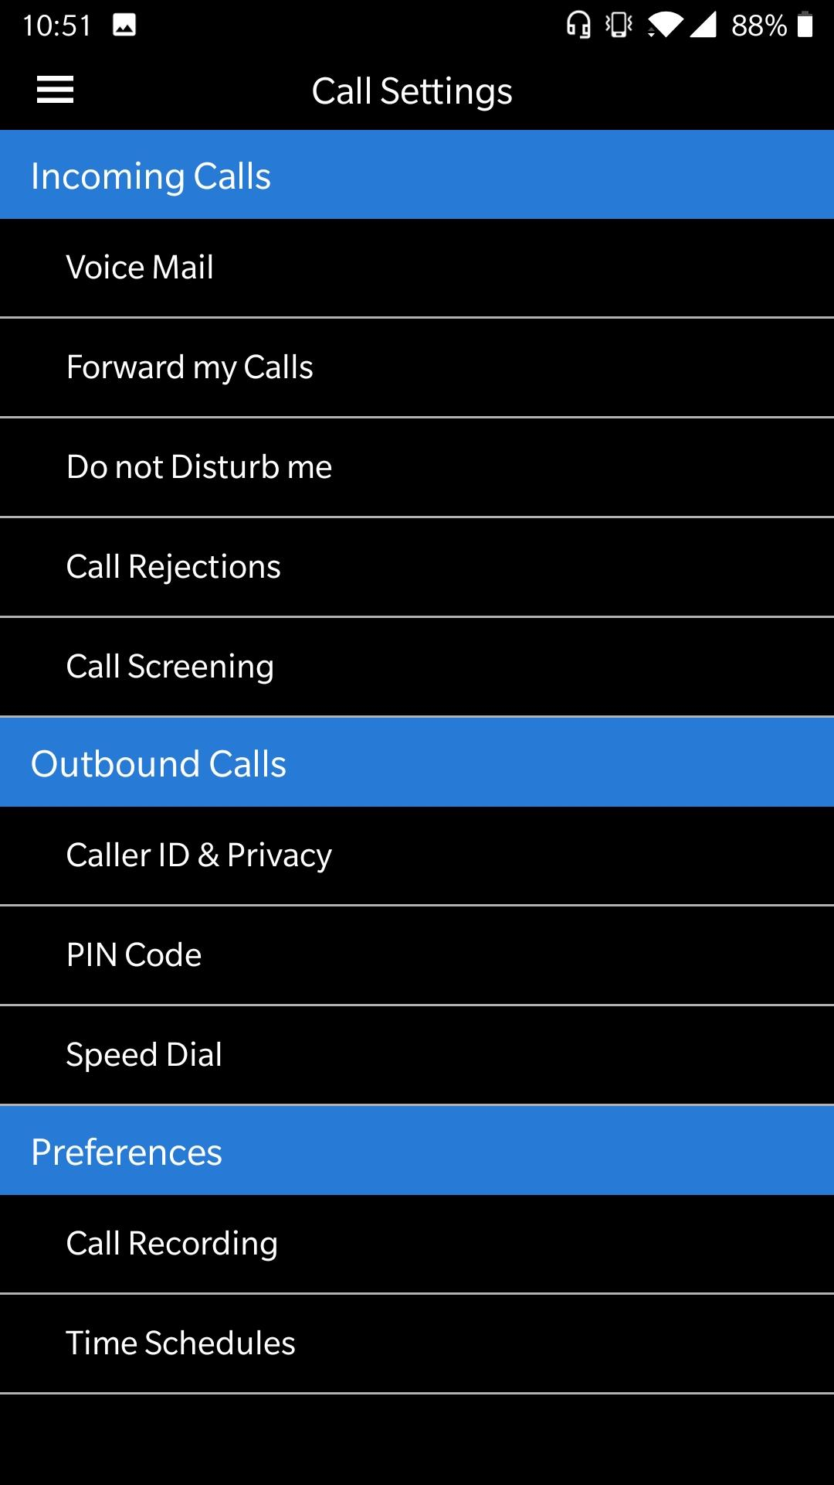
Value-Add Example - Voice

Slide 10

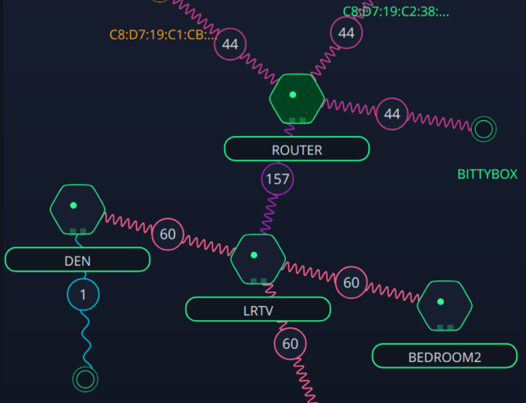
Value-Add Example - A.I WiFi

Slide 11

Q&A
Any open questions?

Slide 12
Last but not least
Benefits & Concerns
and
Thank you

