Slide 1
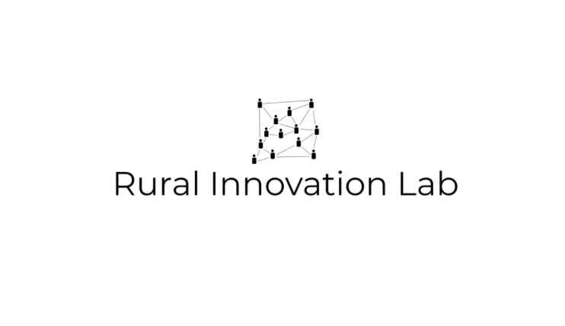
Mat Hocken

Slide 2
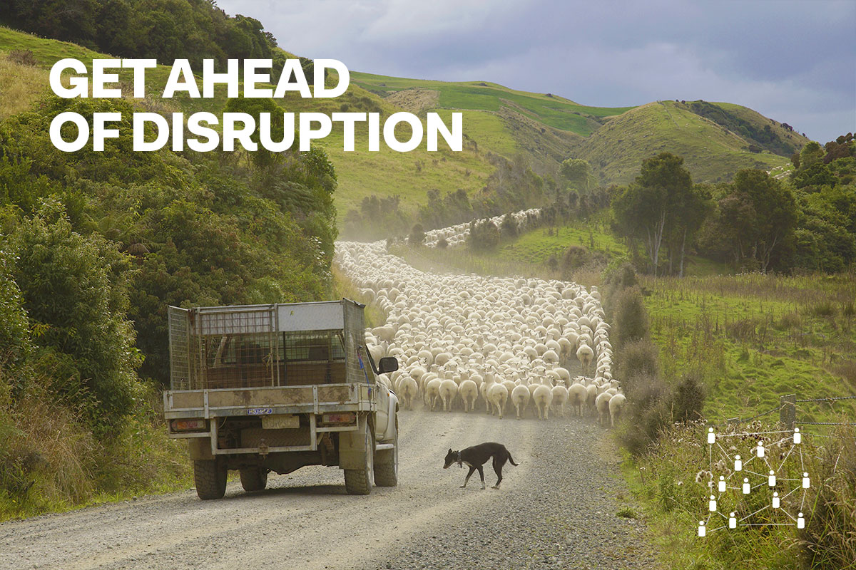

Slide 3
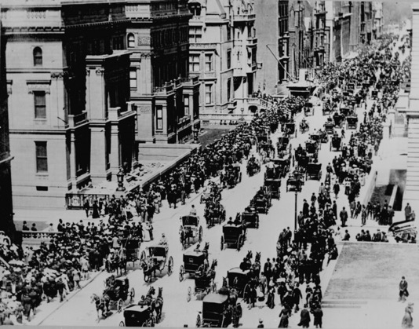
5th Av
New York 1900
Notes:
5th Avenue New York 1900 – spot the car?

Slide 4
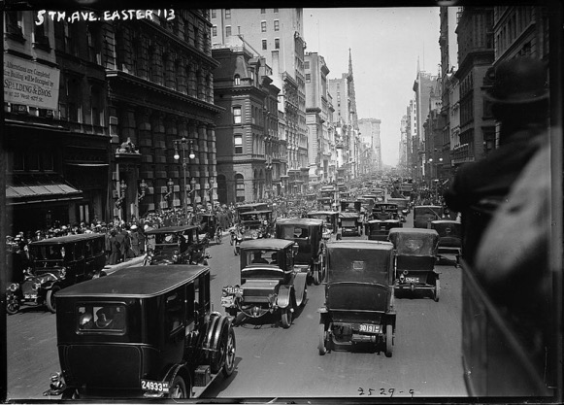
5th Av
New York 1913
Notes:
5th Avenue NY 1913 - Spot the carriage?
Over a dozen years city streets changed dramatically
Switch from hay-fueled transport to oil fueled transport big implications for agriculture
Big impact on the cities. Big impact out in the country.
Millions of acres (25% of Americas harvested area) no longer needed for horsefeed

Slide 5
NZ 1919

Slide 6
NZ 1931
Notes:
In 1919 there were 130 tractors in NZ. In 1931 5,000 tractors. 12 years
We have faced disruption before and we’re still here!
Today our challenges are quite different and require a fresh approach.
Best anti-dote to disruption is to innovate and build our capacity to continue to innovate.
Farmers and growers must and will play a key role in leading and driving that innovation.

Slide 7
“We are committed to meeting the greatest challenge humanity faces; rapidly moving to a low carbon emissions society, restoring the health of our water, reversing the decline in biodiversity and at the same time, feeding our people.”
NZ Primary Sector Council

Slide 8
Key obstacles to agri innovation: lack of collaboration, slow uptake of technology and innovation by the farming sector, lack of skills and skill development, lack of a coordinated and focused sector, need to accelerate commercialisation.”
NZ Agritech Sector Strategy

Slide 9
Agritech hackathon 2017
Notes:
Group of interested farmers
Hackathon 2017
Nuffield on innovation
Rural innovation lab

Slide 10
Notes:
The vision of the RIL is for New Zealand farmers and growers to be the smartest, most innovative and sustainable food producers in the world. Our purpose is to create a network of smartfarms and smartfarmers to drive better innovation in agriculture and food.
The Rural Innovation Lab (RIL) is the result of a ten-month long pilot project in the Manawatu/Whanganui region in 2019, which saw a diverse range of parties collaborating to design a process whereby farmers and growers could engage with innovators, and solutions were developed to burning issues facing our agricultural sector.
The pilot validated the need for a community of innovative farmers and growers to be established in New Zealand, where research institutes, corporates and innovators could come to get user feedback and input to inform the development of solutions for agriculture.
We are unique because we are producer led; we work collaboratively, both within the agricultural sector and with the best innovation partners; we focus on wicked problems and market failures; and we operate with a succeed and fail fast mentality.
The engagement of farmers and growers in a farmer network that solves problems facing agriculture will mean:
- Finding innovative and out of the box solutions to agriculture’s pressing problems - environmental, cultural & social - that transcend existing sector boundaries and knowledge
- The development of solutions that are validated and tested by end users during development, and therefore more likely to be commercially successful, and reduce innovation cycle timeframes
- Increased capability and capacity of farmers and growers to respond to pressing issues facing the sector
- Improved wellbeing for farmers and growers, who are able to positively influence solutions and build confidence and sense of autonomy.
A core role of the RIL is to ensure that expenditure on agtech and innovation is fit for purpose and meets users needs. Hype around agtech is plentiful, as is conversation around the need for farmers to 'adopt' the new technologies - but they are of little use if they do not have practical applications for farmers and growers and a strong on farm business case - as we have discovered through working closely with farmers this year.
The Rural Innovation Lab serves to speed up the cycle of innovation, through farmer and grower input into development of new technologies and innovations.

Slide 11
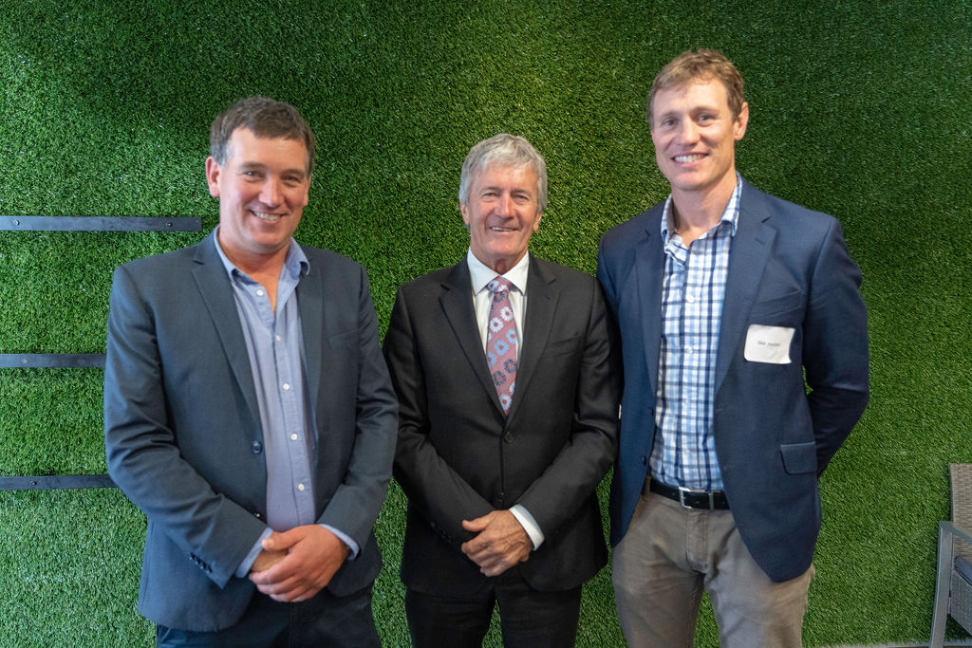

Slide 12
Notes:
Ware in the process of establishing a national farmer network (the smartfarm network) which will act as a 'Field Lab' - a living laboratory where researchers and innovators engage with farmers and growers to collaboratively find solutions to pressing issues.
One of the first projects the Lab is tackling is the development of a 'farm digital twin’ which will allow farmers to see their business holistically, in order to provide greater information for management decisions, and protects farmers from having their data held by for-profit actors.

Slide 13
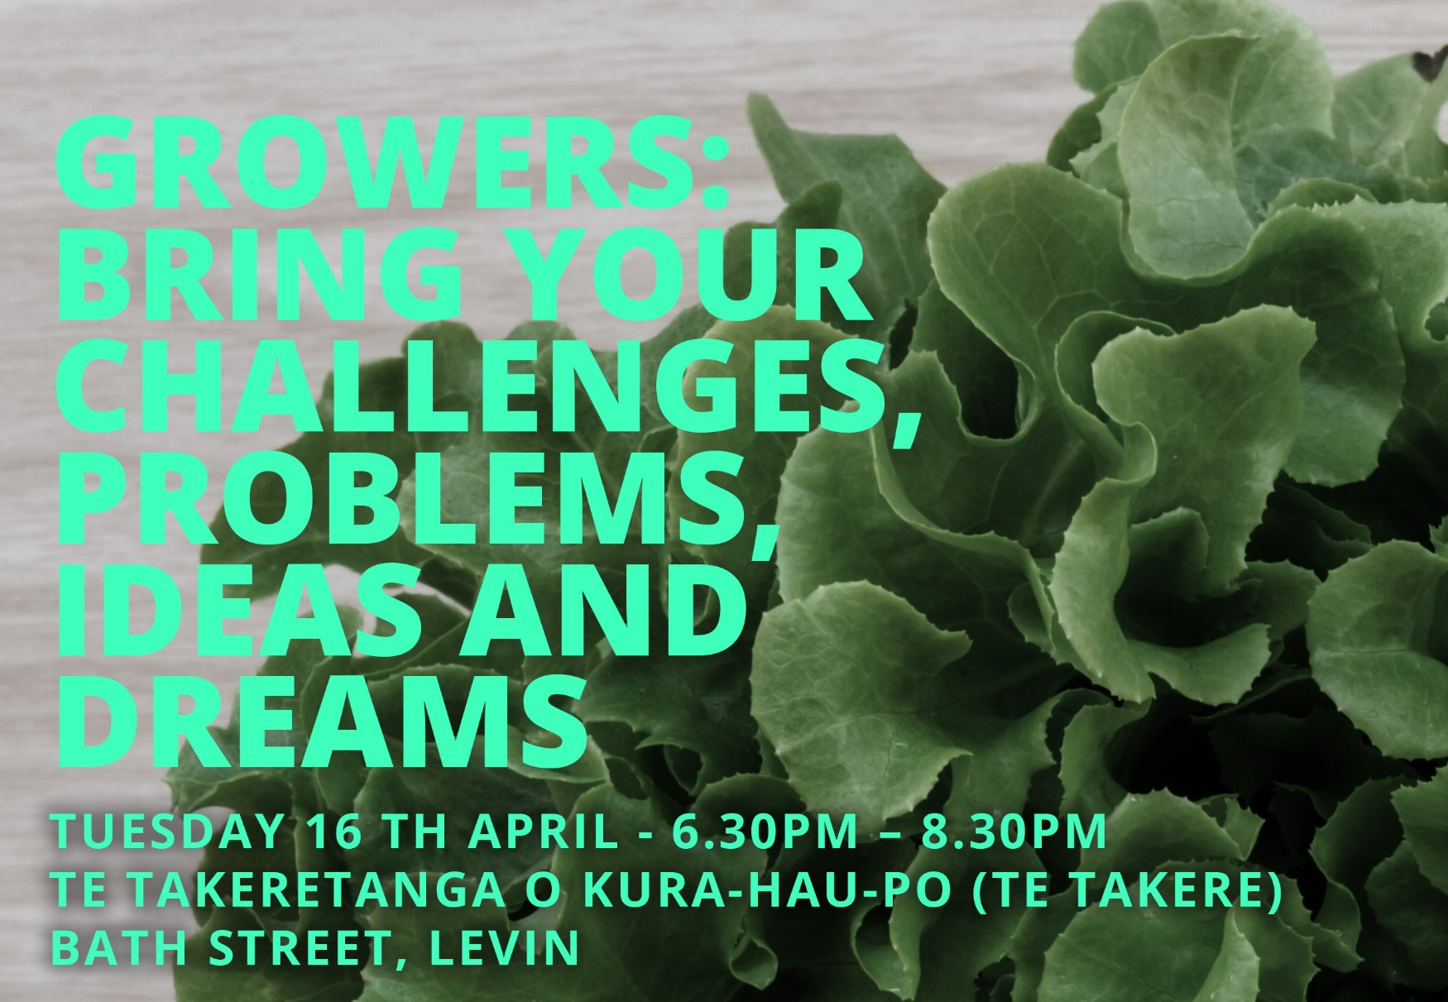

Five themes
Getting closer to consumers
Creating new business models
Understanding and enhancing our environmental footprint
Data for better decision making
Driving value from regulation and compliance

Slide 14

1. Getting closer to consumers
How do we verify and present best practice in a meaningful manner for discerning customers and communities?
How do we collectively understand what consumers want and efficiently respond to changing consumer demands?
How could technology help to create guarantees re product safety/food security?

Slide 15
2. Creating new business models
How do we leverage our land assets through multiple revenue streams to build resilience into farming businesses?
How do we engage whole farm teams in the business of farming, for joint wealth and growth?
How do we create a ‘why’ for the whole farm team?

Slide 16
3. Understanding and enhancing our environmental footprint
How can we understand our carbon footprint on a farm by farm basis?
How do we create a system to incentivise joint rural and urban wealth creation in an environmentally, culturally and socially sustainable manner?
How can we utilise technology and knowledge to be more efficient with water use, both for reuse and storage?

Slide 17
4. Data for better decision making
How do we collaboratively share data in a manner which enables faster more flexible business innovation?
How do we create a better trusted information flow to farmers?
What should we be automating and tracking?

Slide 18
5. Driving value from regulation and compliance
How can the compliance burden can be shifted to add value to their businesses, through delivering greater returns or an improved market position.
How do we create value from animal identification systems, beyond biosecurity?
How do we turn compliance into value creation?

Slide 19


What can Wispa members help us with?

