Slide 1

Wholesaling as a Value Add
How to get new clients for free

Slide 2

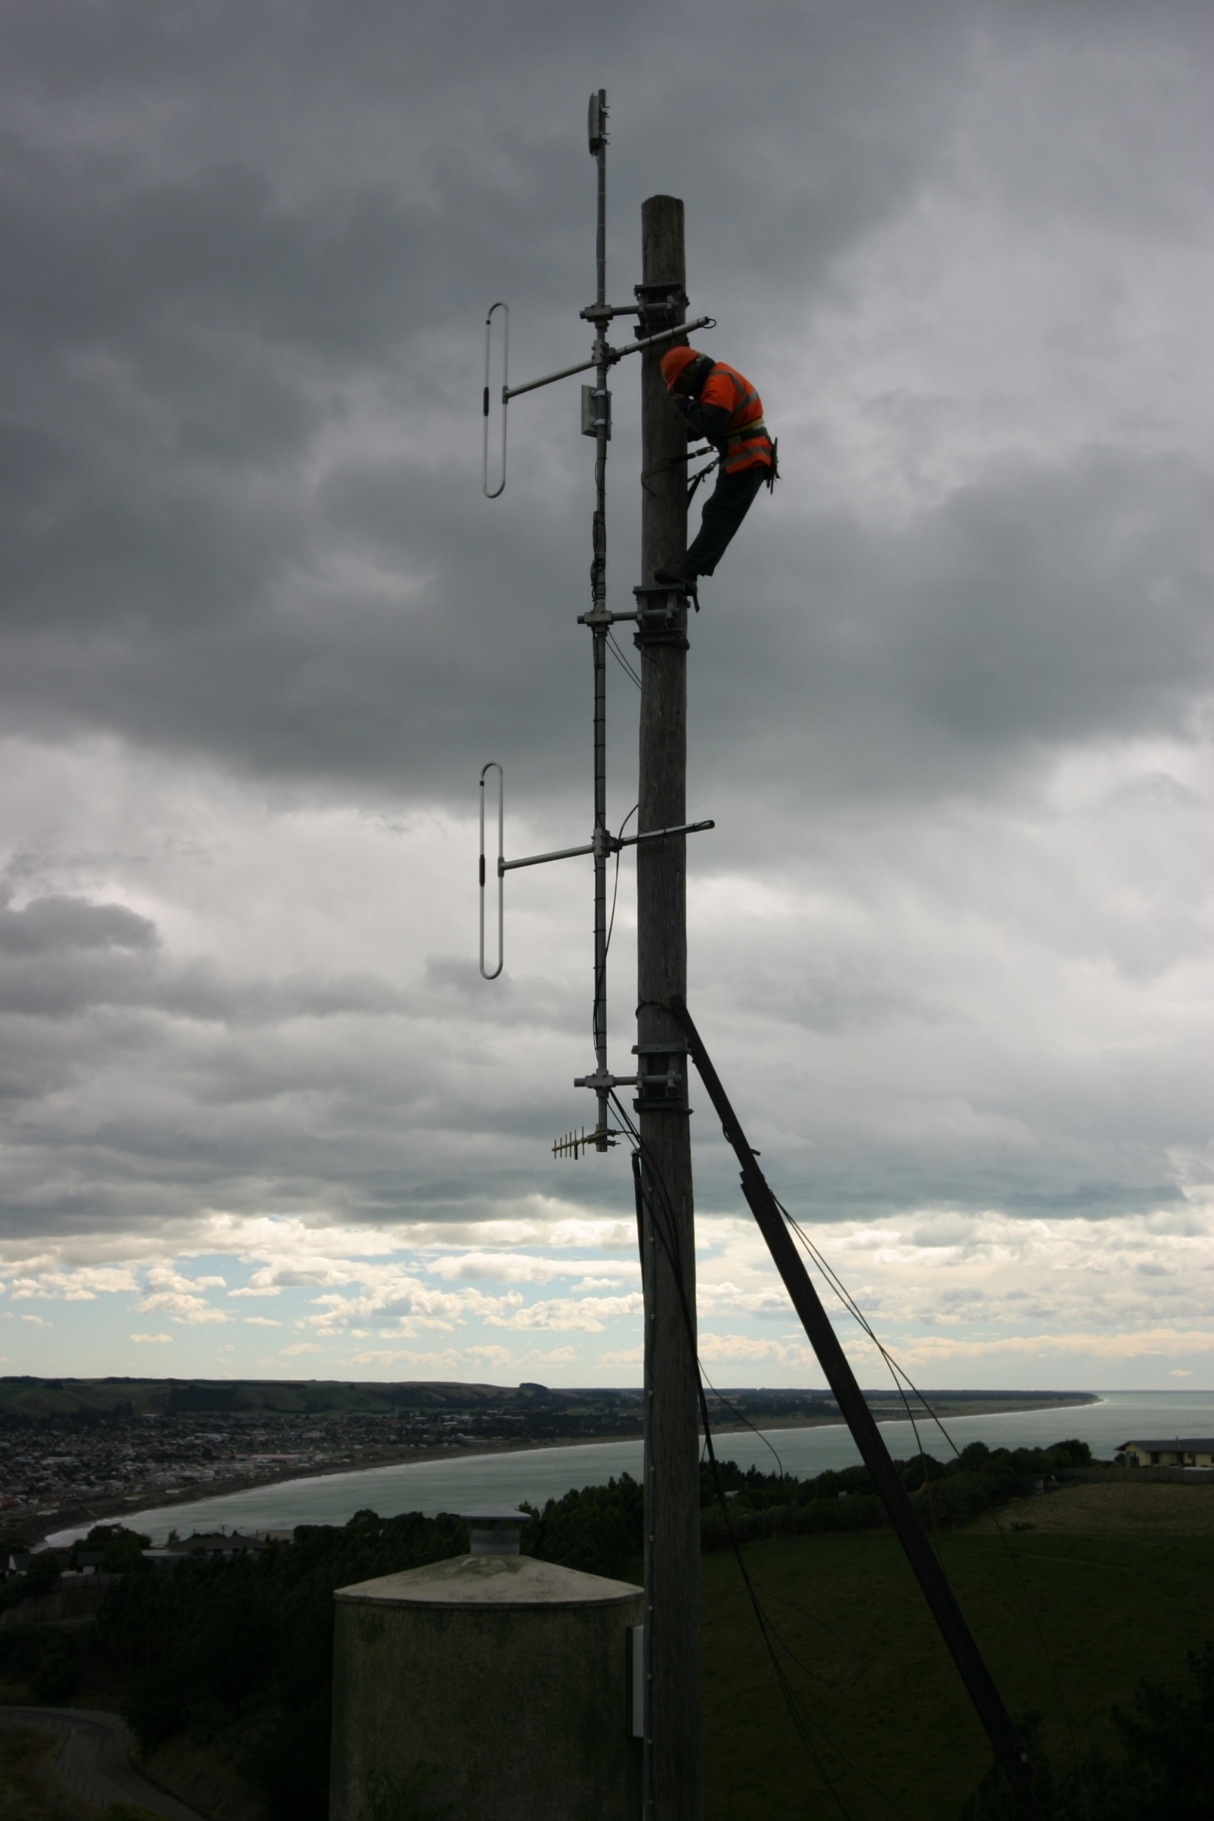
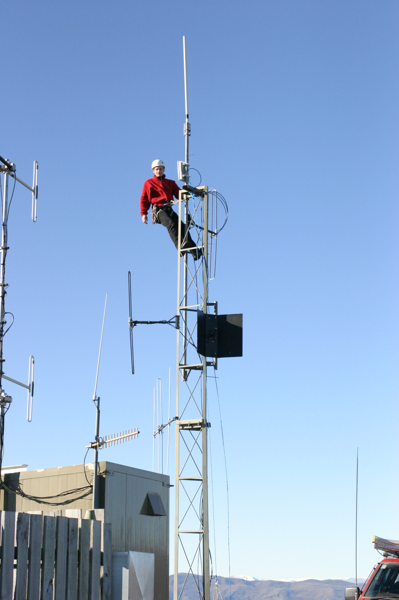
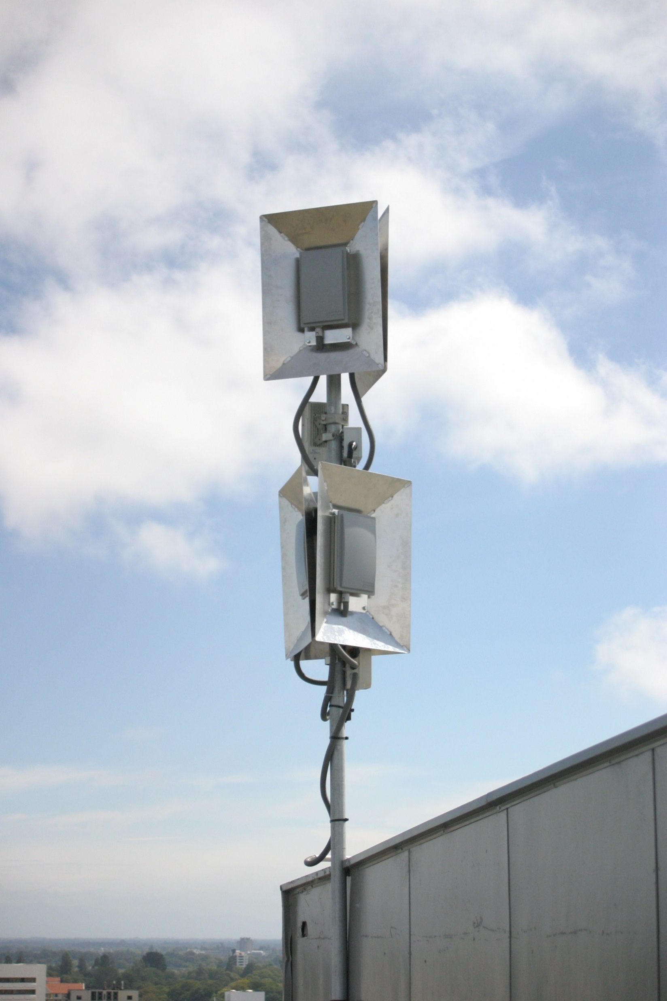
Started in 2003 with three wireless franchises
Oamaru
Wanaka
Christchurch

Slide 3
2006 - BCL (Kordia) Extend
2011 - RBI Vodafone
2019 – Spark Wholesale
2020 - ?

Slide 4
Netspeed is a retailer
We spend a small fortune on nationwide marketing
Standard theory is that 50% of that is wasted
We get calls from all over the country and some of those, we can’t connect
We are looking for more ways to connect new clients
We are looking for better options for existing clients

Slide 5
Why Wholesale to Netspeed?
You get connections for free – no marketing required
Multiple connections from one customer means no support required
Low impact connections - no IP address or IP transit required
We pay our bills on time, every time

